Slide 1

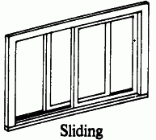
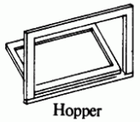
MEMS Battery operated project
Project Number 16-1-1-1127
Submitting
Mari Mishel
Daniel Akua
Advisor
Arkadi Rafalovich

Slide 2
Project Purpose - Background
Entrances and exits are your home's weakest points.
Unsecured door or window is a vulnerability.
Entry sensors are used to identify entry point movement.
In the past a bell was used. The bell made noise whenever the door hit him.
Today the technology has improved and the market offers different, more advanced options.

Slide 3
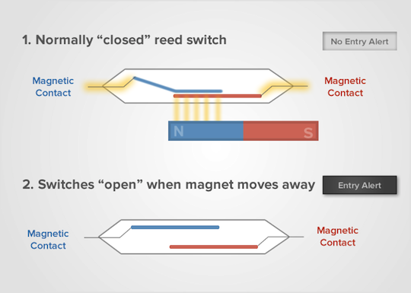
Entry sensor example - Magnetic
The most common entry sensors today use a reed switch and a magnet. Reed switch consists of electrical connectors placed slightly apart. When a magnetic field is placed parallel to the switch, it closes the circuit. When the magnet moves away, the circuit is open and an alarm is triggered.

Slide 4
Entry sensor example - Magnetic
However, the magnetic sensor has some disadvantages:
Consists of 2 parts where one is installed on the window and the other installed on the frame.
Can’t fit all windows and doors, deep frame for example.
Can be affected by metal objects.
Can be fooled by a special magnet to open without triggering alarm.

Slide 5
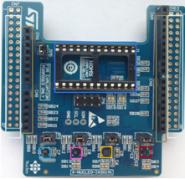
Our project – Motion sensor
Motion sensor uses an accelerometer and a gyroscope to sample acceleration and angular velocity.
By mounting the motion sensor on a micro controller we can sample repeatedly, and calculate changes in velocity, location and angle.

Slide 6
General window opening detection
The algorithm, placed in the micro controller:
The accelerometer samples vibrations on the window constantly at 200 samples per second.
The algorithm checks the output values from the accelerometer and the gyroscope.
If the value is above a threshold value, calculate displacement.
Calculate current position of the window (compared to initial position).
If the location moved from initial position, opening event is detected. If location is same as initial position, closing event detected.
Algorithm notifies that the window is open/closed and back to 2.

Slide 7
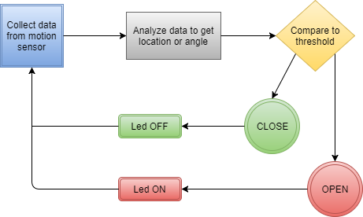
General window opening detection

Slide 8


Sliding window opening detection
This window’s opening can be detected by calculating the change in location. The data sampled from the accelerometer goes through double integration.
The starting location is considered as 0. Assumption: system starts when the window is closed.
$$velocity=\int{(ac{celerometer}_{data}) dt}$$
$$location=\int{(velocity) dt}$$
Integration tends to gain errors. Therefore, each bulk of velocity values lower than 15 cm/s are written as 0. The same is done for location, each bulk of location values lower than 5 cm are written as 0. This filtering corrects the integration errors. Each integration adds values, but if the windows is not moving, the only thing that is integrated is noise.

Slide 9
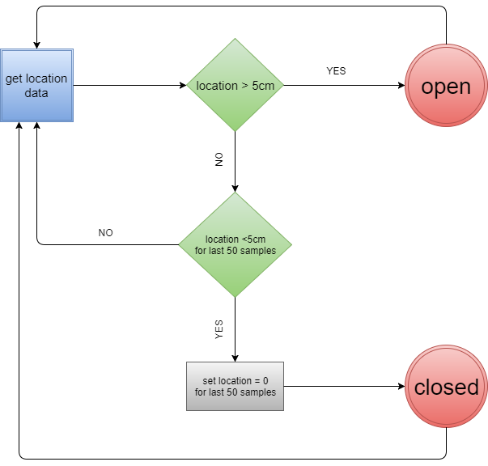
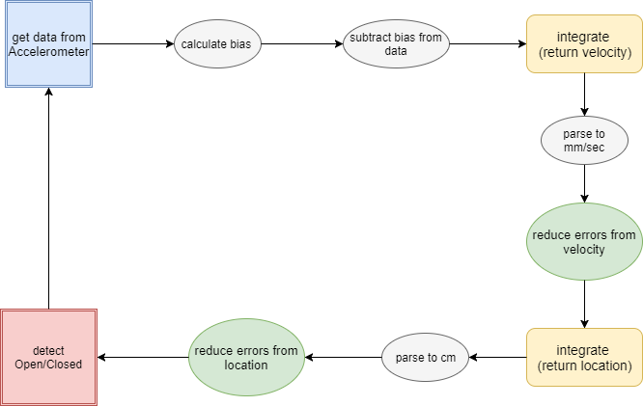
Sliding window operation diagram

Slide 10
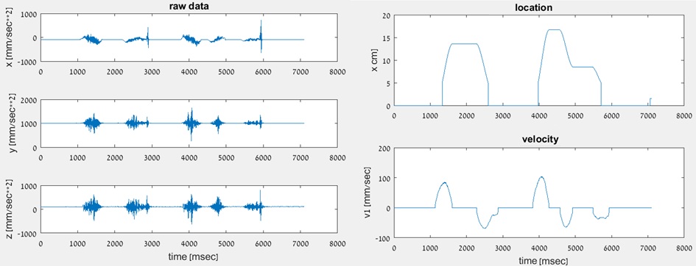
Sliding window experiment results
Raw data - each graph represents the raw data from the accelerometer in each axis. The y and z axes represent only noise they’re actually 0 (gravitation). The movement is only on x.
Velocity and location – first graph is the location graph and the second is the velocity graph.

Slide 11
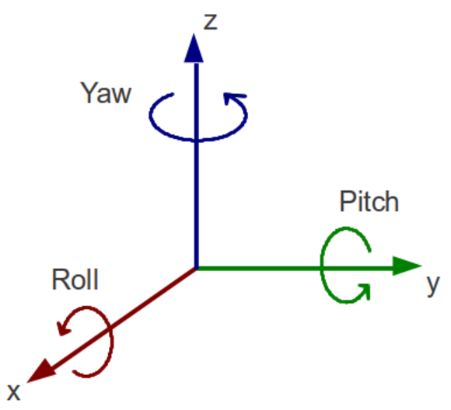

Calculating pitch and roll
Theory for Hopper\Awning Window
For our next window, we will need to calculate tilt:
With a 3-axis accelerometer, we can use the Z-axis to combine with the X and Y axes for tilt sensing in order to improve tilt sensitivity and accuracy.

Slide 12
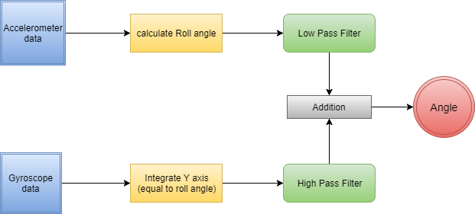
Complementary filter
In order to surpass the gyroscope’s drift and the accelerometer’s vibrations errors, we will use complementary filter. This algorithm produce a signal that is not suffering from the errors of the accelerometer and the gyroscope.
LPF filters high frequency signals (accelerometer’s vibrations).
HPF filters the low frequency signals (gyroscope’s drift).
Integrator creates an angle from angular velocity (gyroscope’s samples).

Slide 13
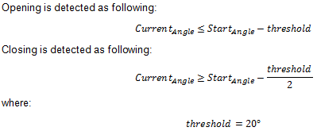
Hopper window opening detection
This window’s opening can be detected by calculating the change in the angle. The data sampled from the accelerometer and the gyroscope goes through complementary filter. The resulting angle is compared to the threshold to determine opening/closing event as follows:

Slide 14
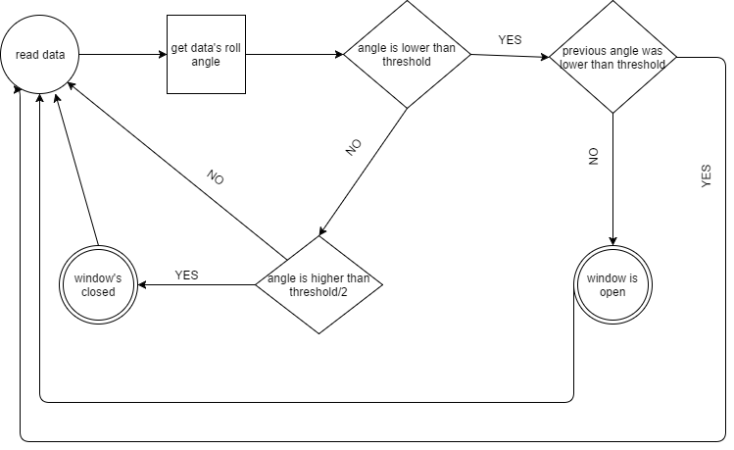
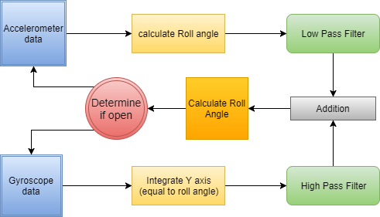
Hopper window operation diagram

Slide 15
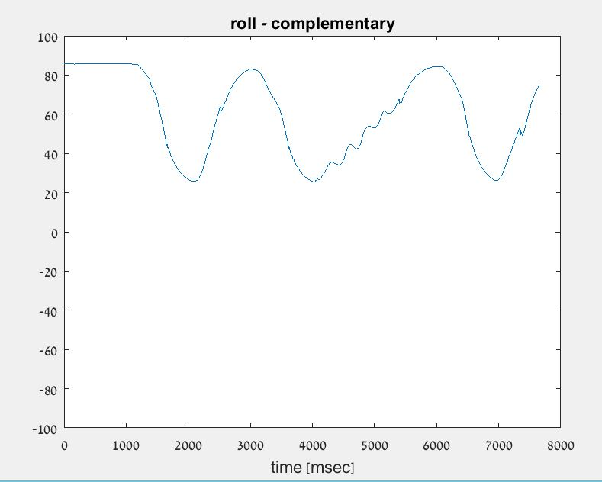
Hopper window experiment results
Hopper window uses roll angle to determine opening.
The graph represents the roll angle from complementary filter.
We can see that the hopper window was opened and closed completely 3 times.

Slide 16
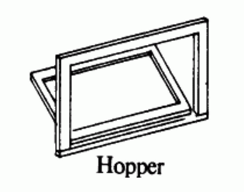
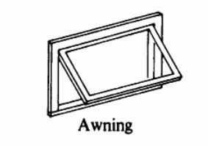
Live demo – Hopper/Awning window
We would like to show a live demo of opening and closing detection of hopper or awning window. According to our program, the led is on when the window is open and off when the window is closed. Additionally, the program outputs open/close repeatedly (in case its hard to see the led from certain angles).

